Slide 1
Design and Analysis of Algorithms
Algorithms-II : CS345A
Lecture 5
Divide and Conquer Paradigm - IV
Polynomial Multiplication

Slide 2
An algorithm for multiplying two polynomials
Problem 4

Slide 3
Multiplying two polynomials
Definition (polynomial of degree less than $n$)
$$A\left(x\right)=a_{0}+a_{1}x+a_{2}x^{2}+ …a_{n−1}x^{n−1}$$
Problem : Given two polynomial of degree less than $n$,
$$A\left(x\right)=a_{0}+a_{1}x+a_{2}x^{2}+ …a_{n−1}x^{n−1}$$
$$B\left(x\right)=b_{0}+b_{1}x+b_{2}x^{2}+ …b_{n−1}x^{n−1}$$
Compute $C=A × B$
$$C\left(x\right)=\sum_{0≤i<2n−1}{c_{i}x^{i}}$$
where $c_{i}$ =
Trivial algorithm: O( $n^{2}$)
Aim: O( $n$ $\log{n}$)
Applications:
Signal processing (Discrete Fourier Transform)
As practical as sorting and searching
Multiplication of two integers.
$$a_{0}b_{i}+a_{1}b_{i−1}+a_{2}b_{i−2}+ …+a_{i−1}b_{1}+a_{i}b_{0}$$
O($i$) time

Slide 4

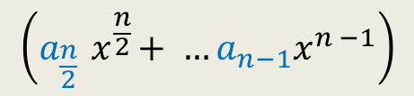


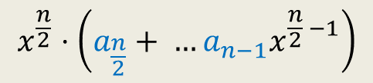

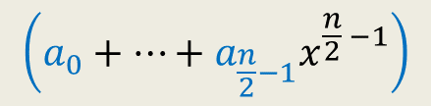

Divide Step
Attempt 1
$$A\left(x\right)=a_{0}+a_{1}x+a_{2}x^{2}+ …a_{n−1}x^{n−1}$$
$$A\left(x\right)= ? + ?$$
$$A\left(x\right)=A_{first}\left(x\right)+{ x}^{\frac{n}{2}} A_{second}\left(x\right)$$
$$\left(a_{0}+…+a_{\frac{n}{2}−1}x^{\frac{n}{2} −1}\right)$$
$$x^{\frac{n}{2}}⋅\left(a_{\frac{n}{2}}+ …a_{n−1}x^{\frac{n}{2} −1}\right)$$
$$\left(a_{\frac{n}{2}}{ x}^{\frac{n}{2}}+ …a_{n−1}x^{n −1}\right)$$
First $\frac{n}{2}$ terms of $A\left(x\right)$
Last $\frac{n}{2}$ terms of $A\left(x\right)$
$$A_{first}\left(x\right)$$
$$A_{second}\left(x\right)$$
Notes:
We can evaluate x^{n/2} in log n time for any given value of x: by repeated squaring:
For example, to compute x^1024, we compute and square x^512.
To compute x^512, we compute and square x^128.
To compute x^128, we copute and square x^64
…
To compute x^2, we square x.
So just O(log n) arithmetic operations are needed.

Slide 5

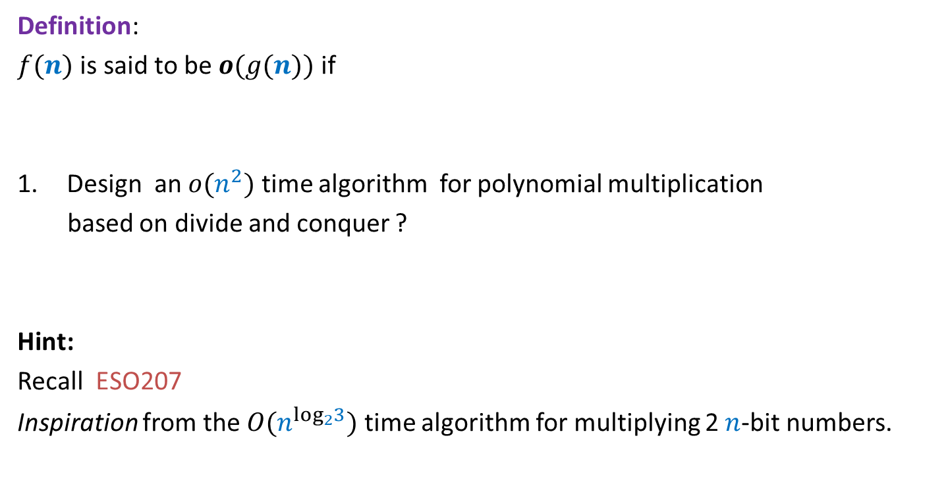
Homework from the last class
Definition:
$f(n)$ is said to be $o(g(n))$ if
Design an $o(n^{2})$ time algorithm for polynomial multiplication
based on divide and conquer ?
Hint:
Recall ESO207
Inspiration from the $O(n^{\log_{2}3})$ time algorithm for multiplying 2 $n$-bit numbers.
$$\lim_{n→∞}{ \frac{f\left(n\right)}{g\left(n\right)}=0}$$

Slide 6
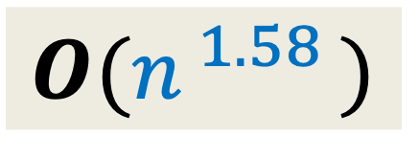




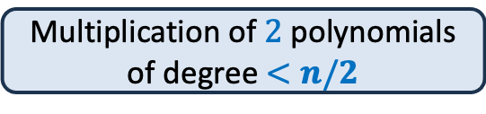

$O(n^{\log_{2}3})$ time algorithm
$$O(n^{ 1.58 })$$
$$A\left(x\right)=A_{first}\left(x\right)+{ x}^{\frac{n}{2}} A_{second}\left(x\right)$$
$$B\left(x\right)=B_{first}\left(x\right)+{ x}^{\frac{n}{2}} B_{second}\left(x\right)$$
$A\left(x\right)×B\left(x\right)$ =
$$4 ×$$
Multiplication of $2$polynomials of degree $<n/2$
$T(n) = cn + 4 T(n/2)$
$$3$$

Slide 7

Representation of a polynomial ?
Coefficient representation:
$$A\left(x\right)=a_{0}+a_{1}x+a_{2}x^{2}+ …a_{n−1}x^{n−1}$$
$<a_{0}, a_{1},a_{2},…,a_{n−1}>$

Slide 8
Representation of a polynomial ?
Alternate representation of polynomial
“$A\left(x\right)=a_{0}+a_{1}x$”
{$(r_{0}, A\left(r_{0}\right)),(r_{1}, A\left(r_{1}\right))$}
for any distinct $r_{0}$ and $r_{1}$uniquely define $A\left(x\right)$.
Alternate representation of polynomial “$A\left(x\right)=a_{0}+a_{1}x+a_{2}x^{2}$”
{$(r_{0}, A\left(r_{0}\right)),(r_{1}, A\left(r_{1}\right))$, $(r_{2}, A\left(r_{2}\right))$}
for any distinct $r_{0}$,$r_{1}$, and $r_{2}$ uniquely define $A\left(x\right)$.
$$(r_{1}, A\left(r_{1}\right))$$
$$(r_{2}, A\left(r_{2}\right))$$
$$(r_{0}, A\left(r_{0}\right))$$
$$(r_{1}, A\left(r_{1}\right))$$
$$(r_{0}, A\left(r_{0}\right))$$

Slide 9

Representation of a polynomial ?
Theorem:
Let {$(r_{0},t_{0}),(r_{1},t_{1})$, …, $(r_{m−1}, t_{m−1})$} be $m$ pairs of numbers with all $r_{i}$’s distinct.
There exists a unique polynomial $A$ of degree less than $m$ such that
$A\left(r_{i}\right)=t_{i}$ $∀ i$
Proof: Elementary matrix theory.
(point,value) representation of a polynomial

Slide 10



Questions
$A$ and $B$: two polynomial of degree less than $n$,
and
$C=A × B$
and
{$r_{0},r_{1}, r_{m−1}$}: any $m$ distinct numbers
If we are given {$A\left(r_{0}\right),A\left(r_{1}\right),…$ ,$A\left(r_{m−1}\right)$} and {$B\left(r_{0}\right),B\left(r_{1}\right),…$ ,$B\left(r_{m−1}\right)$}
Question 1 : How efficiently can we compute {$C\left(r_{0}\right),C\left(r_{1}\right),…$ ,$C\left(r_{m−1}\right)$} ?
Question 2 : What should be the smallest value of $m$ such that
{$\left(r_{0}, C\left(r_{0}\right)\right),…,(r_{m−1}, C\left(r_{m−1}\right)$} is a (point,value) representation of $C$ ?
O($m$) time
$$2n−1$$

Slide 11

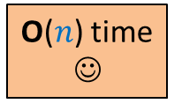

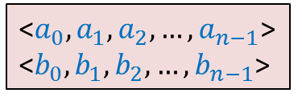
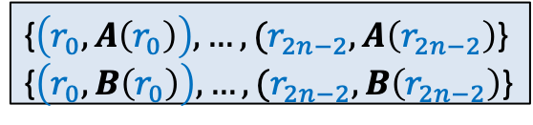
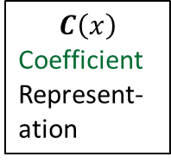


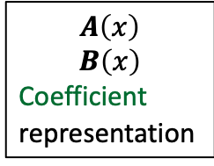

$C=A × B$
☹
$$C\left(x\right)$$
Coefficient
Represent-ation
$$A\left(x\right)$$
$$B\left(x\right)$$
Coefficient
representation
<$a_{0}, a_{1},a_{2},…,a_{n−1}$>
<$b_{0}, b_{1},b_{2},…,b_{n−1}$>
<$c_{0}, c_{1},c_{2},…,c_{2n−2}$>
O($n$ log $n$) time
O($n$ log $n$) time
Polynomial Evaluation
Polynomial Interpolation
{$\left(r_{0}, A\left(r_{0}\right)\right),…,(r_{2n−2}, A\left(r_{2n−2}\right)$}
{$\left(r_{0}, B\left(r_{0}\right)\right),…,(r_{2n−2}, B\left(r_{2n−2}\right)$}
{$\left(r_{0}, C\left(r_{0}\right)\right),…,(r_{2n−2}, C\left(r_{2n−2}\right)$}
O($n$) time
☺

Slide 12

Polynomial Evaluation Problem
Given a polynomial $A$ of degree less than $n$in coefficient representation,
Choose any set $S$ of $n$ numbers
Compute $A\left(v\right)$ for all $v∈S$.
Assumption:
$n$ is a power of 2.
Please choose set $S$with a hope that it would be help design an efficient algorithm ☺.

Slide 13
a Divide and Conquer algorithm for
Polynomial Evaluation Problem

Slide 14


Divide Step
Idea ?
$$A\left(x\right)=a_{0}+a_{1}x+a_{2}x^{2}+ …a_{n−1}x^{n−1}$$
$$S$$
Try to express $A\left(x\right)$ as 2 polynomials of degree less than $\frac{n}{2}$.

Slide 15







Divide Step
Attempt 1
$$A\left(x\right)=a_{0}+a_{1}x+a_{2}x^{2}+ …a_{n−1}x^{n−1}$$
$$S$$
$$A\left(x\right)= ? + ?$$
Evaluating $A$ at $S$ =
$$\left(a_{0}+…+a_{\frac{n}{2}−1}x^{\frac{n}{2} −1}\right)$$
$$x^{\frac{n}{2}}⋅\left(a_{\frac{n}{2}}+ …a_{n−1}x^{\frac{n}{2} −1}\right)$$
$$\left(a_{\frac{n}{2}}{ x}^{\frac{n}{2}}+ …a_{n−1}x^{n −1}\right)$$
First $\frac{n}{2}$ terms of $A\left(x\right)$
Last $\frac{n}{2}$ terms of $A\left(x\right)$
$$A_{first}\left(x\right)$$
$$A_{second}\left(x\right)$$
Evaluating $A_{first}$ at $S$
Evaluating $A_{second}$ at $S$
Evaluating $x^{\frac{n}{2}}$ at $S$
$+$ O($n log n$) time
O($n log n$) time
$+$ O($n$) time
Notes:
We can evaluate x^{n/2} in log n time for any given value of x: by repeated squaring:
For example, to compute x^1024, we compute and square x^512.
To compute x^512, we compute and square x^128.
To compute x^128, we copute and square x^64
…
To compute x^2, we square x.
So just O(log n) arithmetic operations are needed.

Slide 16
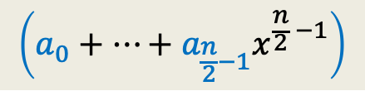
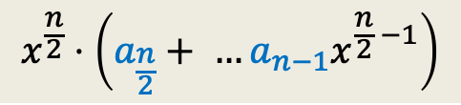
Divide Step
Attempt 1
$$A\left(x\right)=a_{0}+a_{1}x+a_{2}x^{2}+ …a_{n−1}x^{n−1}$$
$$S$$
$$A\left(x\right)= ? + ?$$
Evaluating $A$ at $S$ =
$$\left(a_{0}+…+a_{\frac{n}{2}−1}x^{\frac{n}{2} −1}\right)$$
$$x^{\frac{n}{2}}⋅\left(a_{\frac{n}{2}}+ …a_{n−1}x^{\frac{n}{2} −1}\right)$$
$$A_{first}\left(x\right)$$
$$A_{second}\left(x\right)$$
Evaluating $A_{first}$ at $S$
Evaluating $A_{second}$ at $S$
Evaluating $x^{\frac{n}{2}}$ at $S$
$+$ O($n log n$) time
O($n log n$) time
$+$ O($n$) time
Notes:
We can evaluate x^{n/2} in log n time for any given value of x: by repeated squaring:
For example, to compute x^1024, we compute and square x^512.
To compute x^512, we compute and square x^128.
To compute x^128, we copute and square x^64
…
To compute x^2, we square x.
So just O(log n) arithmetic operations are needed.

Slide 17

Divide Step
Attempt 1
$$A\left(x\right)=a_{0}+a_{1}x+a_{2}x^{2}+ …a_{n−1}x^{n−1}$$
$$S$$
$$A\left(x\right)= ? + ?$$
Evaluating $A$ at $S$ =
$$\left(a_{0}+…+a_{\frac{n}{2}−1}x^{\frac{n}{2} −1}\right)$$
$$x^{\frac{n}{2}}⋅\left(a_{\frac{n}{2}}+ …a_{n−1}x^{\frac{n}{2} −1}\right)$$
$$A_{first}\left(x\right)$$
$$A_{second}\left(x\right)$$
Evaluating $A_{first}$ at $S$
Evaluating $A_{second}$ at $S$
Evaluating $x^{\frac{n}{2}}$ at $S$
$+$ O($n log n$) time
What is the recurrence of the algorithm ?
$T\left(n\right)= cn log n + 2 T(n/2)$
Homework: How will you argue that this is not the correct recurrence for the algorithm.
Notes:
We can evaluate x^{n/2} in log n time for any given value of x: by repeated squaring:
For example, to compute x^1024, we compute and square x^512.
To compute x^512, we compute and square x^128.
To compute x^128, we copute and square x^64
…
To compute x^2, we square x.
So just O(log n) arithmetic operations are needed.

Slide 18






The Recursion Tree
points
for
evaluation
$A\left(x\right)=$ $A_{first}$($x$) + $x^{\frac{n}{2}} A_{second}$($x$)
degree
$$A$$
$$<n$$
$$S$$
$$n$$
$$A_{first}$$
$$A_{second}$$
$$<n/2$$
$$S$$
$$n$$
$$<n/4$$
$$S$$
$$n$$
$$<1$$
$$S$$
$$n$$
$n$ polynomials, each to be evaluated at $n$ distinct numbers
$Θ\left(n^{2}\right)time$☹

Slide 19

















Divide Step
Attempt 2
$$A\left(x\right)= ? + ?$$
$A_{even}(x)$= $a_{0}+a_{2}x+ …+a_{n−2}x^{\frac{n}{2}−1}$
$A_{odd}(x)$ = $a_{1}+a_{3}x+ …+a_{n−1}x^{\frac{n}{2}−1}$,
Evaluating $A$ at $S$ =
$$A\left(x\right)=a_{0}+a_{1}x+a_{2}x^{2}+ …a_{n−1}x^{n−1}$$
$$S$$
$$\left(a_{0}+a_{2}x^{2}+…+a_{n−2}x^{n−2}\right)$$
$$(a_{1}x+a_{3}x^{3}+…+a_{n−1}x^{n−1}\text{)}$$
All odd terms of $A\left(x\right)$
All even terms of $A\left(x\right)$
$x⋅(a_{1}+a_{3}x^{2}+…+a_{n−1}x^{n−2}$)
$$a_{2i}{ x}^{2i}$$
$$a_{2i}{ (x^{2})}^{i}$$
$$a_{2i+1}{ (x^{2})}^{i}$$
$$a_{2i+1}{ x}^{2i}$$
$A\left(x\right)=$ $A_{even}$($x^{2}$) + $x A_{odd}$($x^{2}$)
Evaluating $A_{even}$ at ?
$$S^{2}=$$
$$\left\{c^{2} \right| c∈S\}$$
$$S^{2}$$
Evaluating $A_{odd}$ at $S^{2}$
$+$ O($n$) time

Slide 20
The Recursion Tree
points
for
evaluation
$A\left(x\right)=$ $A_{even}$($x^{2}$) + $x A_{odd}$($x^{2}$)
degree
$$A$$
$$<n$$
$$S$$
$$n$$
Question: Is it possible to select $S$ such that
…
$$A_{even}$$
$$A_{odd}$$
$$<n/2$$
$$S^{2}$$
$$n$$
$$<n/4$$
$$S^{4}$$
$$n$$
$$<1$$
$$S^{n}$$
$$n$$
$n$ polynomials, each to be evaluated at $n$ distinct numbers
$Θ\left(n^{2}\right)time$☹
This hurdle is pointing to a very important question whose answer will solve this problem …
Now recall the set $S$
you selected. What is the size of $S^{2}$, $S^{4}$, …, $S^{n}$ ?
$${|S}^{2}|=\frac{n}{2}$$
$${|S}^{4}|=\frac{n}{4}$$
$${|S}^{n}|=1$$

Slide 21
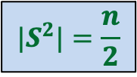



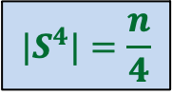
Question
Is it possible to select $S$ such that
…
$$|S^{2}|=\frac{n}{2}$$
$S$ = $\{2,3,9,−2,−3,−9\}$
$${|S}^{4}|=\frac{n}{4}$$
Good start !
But how to satisfy the remaining requirements …
$${|S}^{n}|=1$$

Slide 22
Complex numbers
Recalling elementary facts

Slide 23
Complex numbers
$$\sqrt{a^{2}+b^{2}}$$
$$a+bi$$
$$=r(\cos{φ}+i\sin{φ})$$
$$x_{1} =r_{1}(\cos{φ_{1}}+i\sin{φ_{1}})$$
$$x_{2} =r_{2}(\cos{φ_{2}}+i\sin{φ_{2}})$$
Addition
$x_{1}+x_{2}$ = ?
Multiplication
$x_{1}⋅x_{2}$ = ?
Complex plane
$$b$$
$$r$$
$$φ$$
$$a$$
Vector addition
$$r_{1}r_{2}(\cos{(φ_{1}+φ_{2})}+i\sin{(φ_{1}+φ_{2})})$$
Magnitudes get multiplied &
Arguments get added… beautiful ☺

Slide 24
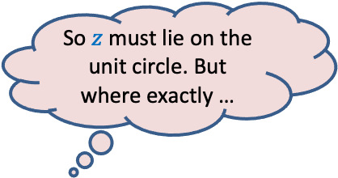

Complex roots of unity
Definition:
A number $z$ is said to be $n$th root of unity
if it satisfies equation.
$$z^{n}=1$$
$$z⋅z⋅z⋅ …⋅z=1$$
Magnitude($z$) = 1
Argument($z$) = ?
$$\{1, ω_{n} ,ω_{n}^{2},ω_{n}^{3},…,ω_{n}^{n−1}\}$$
Complex plane
$$\frac{2π}{n}$$
$$1$$
multiple of $\frac{2π}{n}$
$$R_{n}=$$
Unit circle
So $z$ must lie on the unit circle. But where exactly …
$n^{th}$Principal rool of unity

Slide 25

Complex roots of unity
$$R_{3}$$
What is $\left\{x^{2} \right|x∈R_{3}\}$ ?
$$R_{4}$$
What is $\left\{x^{2} \right|x∈R_{4}\}$ ?
$$ω_{4}^{1}$$
$$ω_{3}^{1}$$
$$ω_{3}^{3}$$
$$ω_{4}^{2}$$
$$ω_{4}^{4}$$
$$ω_{3}^{2}$$
$$ω_{4}^{3}$$

Slide 26




Homework Do it sincerely and meticulously
Answer the questions from the previous slide.
Can you now guess what should be the set $S$ such that
$$|S^{2}|=\frac{n}{2}$$
$${|S}^{4}|=\frac{n}{4}$$
…
$${|S}^{n}|=1$$

